Slide 1
Modernising drug discovery research: An introduction to microphysiological systems (MPS)
Hailey Sze
Scientist
18th Mar 2024
Notes:
Hello everyone, thank you very much for taking the time to join us today and a special thanks to The Alliance Exchange for the invitation! My name is Hailey and I am a scientist at CN Bio. I am really excited to be here today to talk about microphysiological systems and their applications in modernising drug discovery

Slide 2
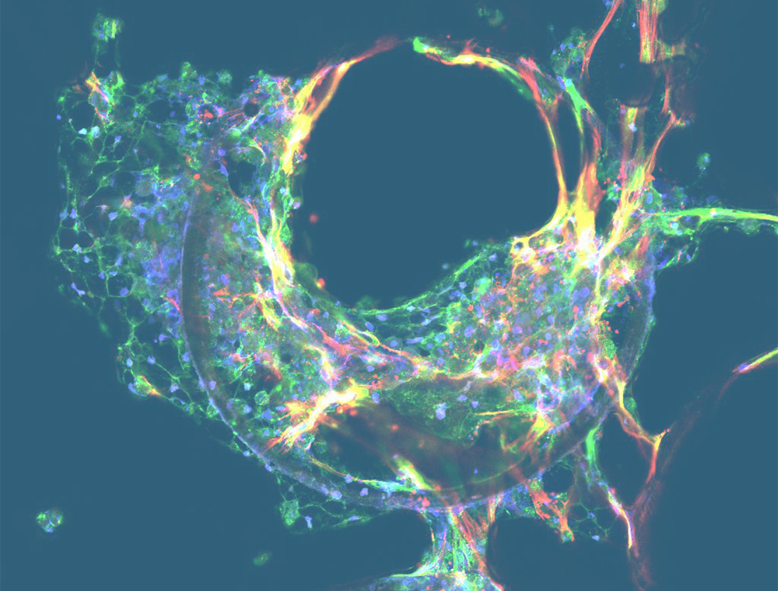
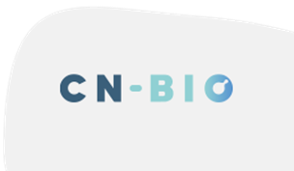
Agenda
The current drug discovery landscape
Current preclinical tools and their challenges
Microphysiological systems (MPS)
CN Bio’s MPS models and application areas
Summary
Notes:
Introduction into drug discovery landscape outline the challenges of current research methodogies. Explain the concept of microphysiological system and how this could potentially bring innovative to preclinical drug discovery. Finally I will introduce the MPS models we have developed at CN Bio and their application areas.

Slide 3
The drug discovery & development process
10-15 YEARS / ~ $2BN/NME
Cycle
time
% Cost
per NME
Probability
of success
Target
validation
~ 1.5 year
~ 3%
-
Compound
screening
~ 1.5 year
~ 6%
-
The process is lengthy, expensive and has low a probability of success.
~ 6Y
Lead
optimization
~ 1.5 year
~ 17%
-
Preclinical test
~ 1 year
~ 7%
-
Phase I
~ 1.5 year
~ 15%
~ 66.4%
Phase II
~ 2.5 year
~ 21%
~ 48.6%
~ 8Y
Phase III
~ 2.5 year
~ 26%
~ 59%
Approval to launch
~ 1.5 year
~ 5%
~ 5%
Efficacy Poor Drug-like properties
Safety Poor market assessment/strategic planning
Notes:
To start off, the drug discovery process consists of multiple steps ranging from the initial target validation and compound screening, to the preclinical tests in cells and animals, before moving onto clinical trials and then finally obtaining approval for use in clinics.
While the market is constantly in a huge demand for new drugs, whole drug discovery process is unfortunately very lengthy, expensive and low chance of success. Out of the whole 10-15 years, 6 years in the preclinical phases, accounting for 33% of total costs before even reaching the clinical trial phase, which then takes another 8 years of clinical testing before being able to release to market (if successful).
Unfortunately, only 10% of all these drugs successfully reach the market. The main reason of drug failures are
- first lack of efficacy,
- followed by unexpected safety issues, o

Slide 4
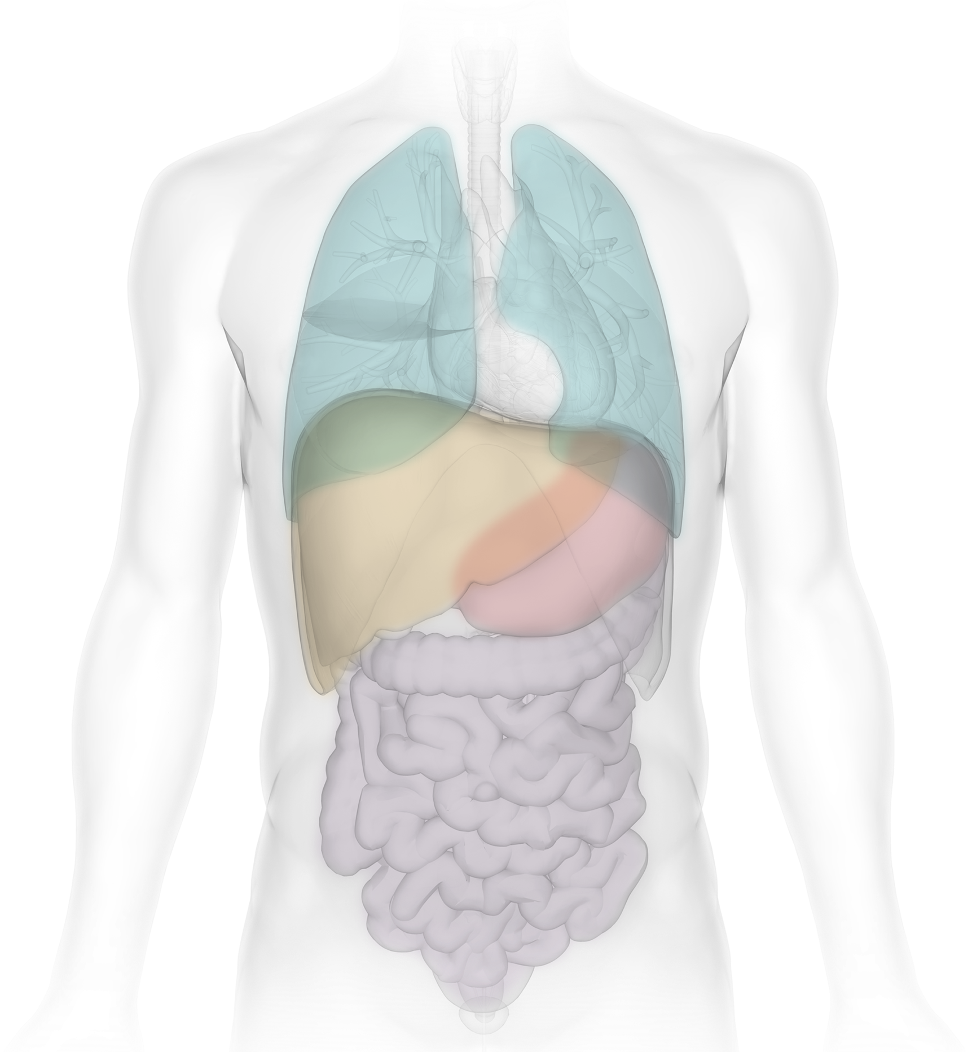
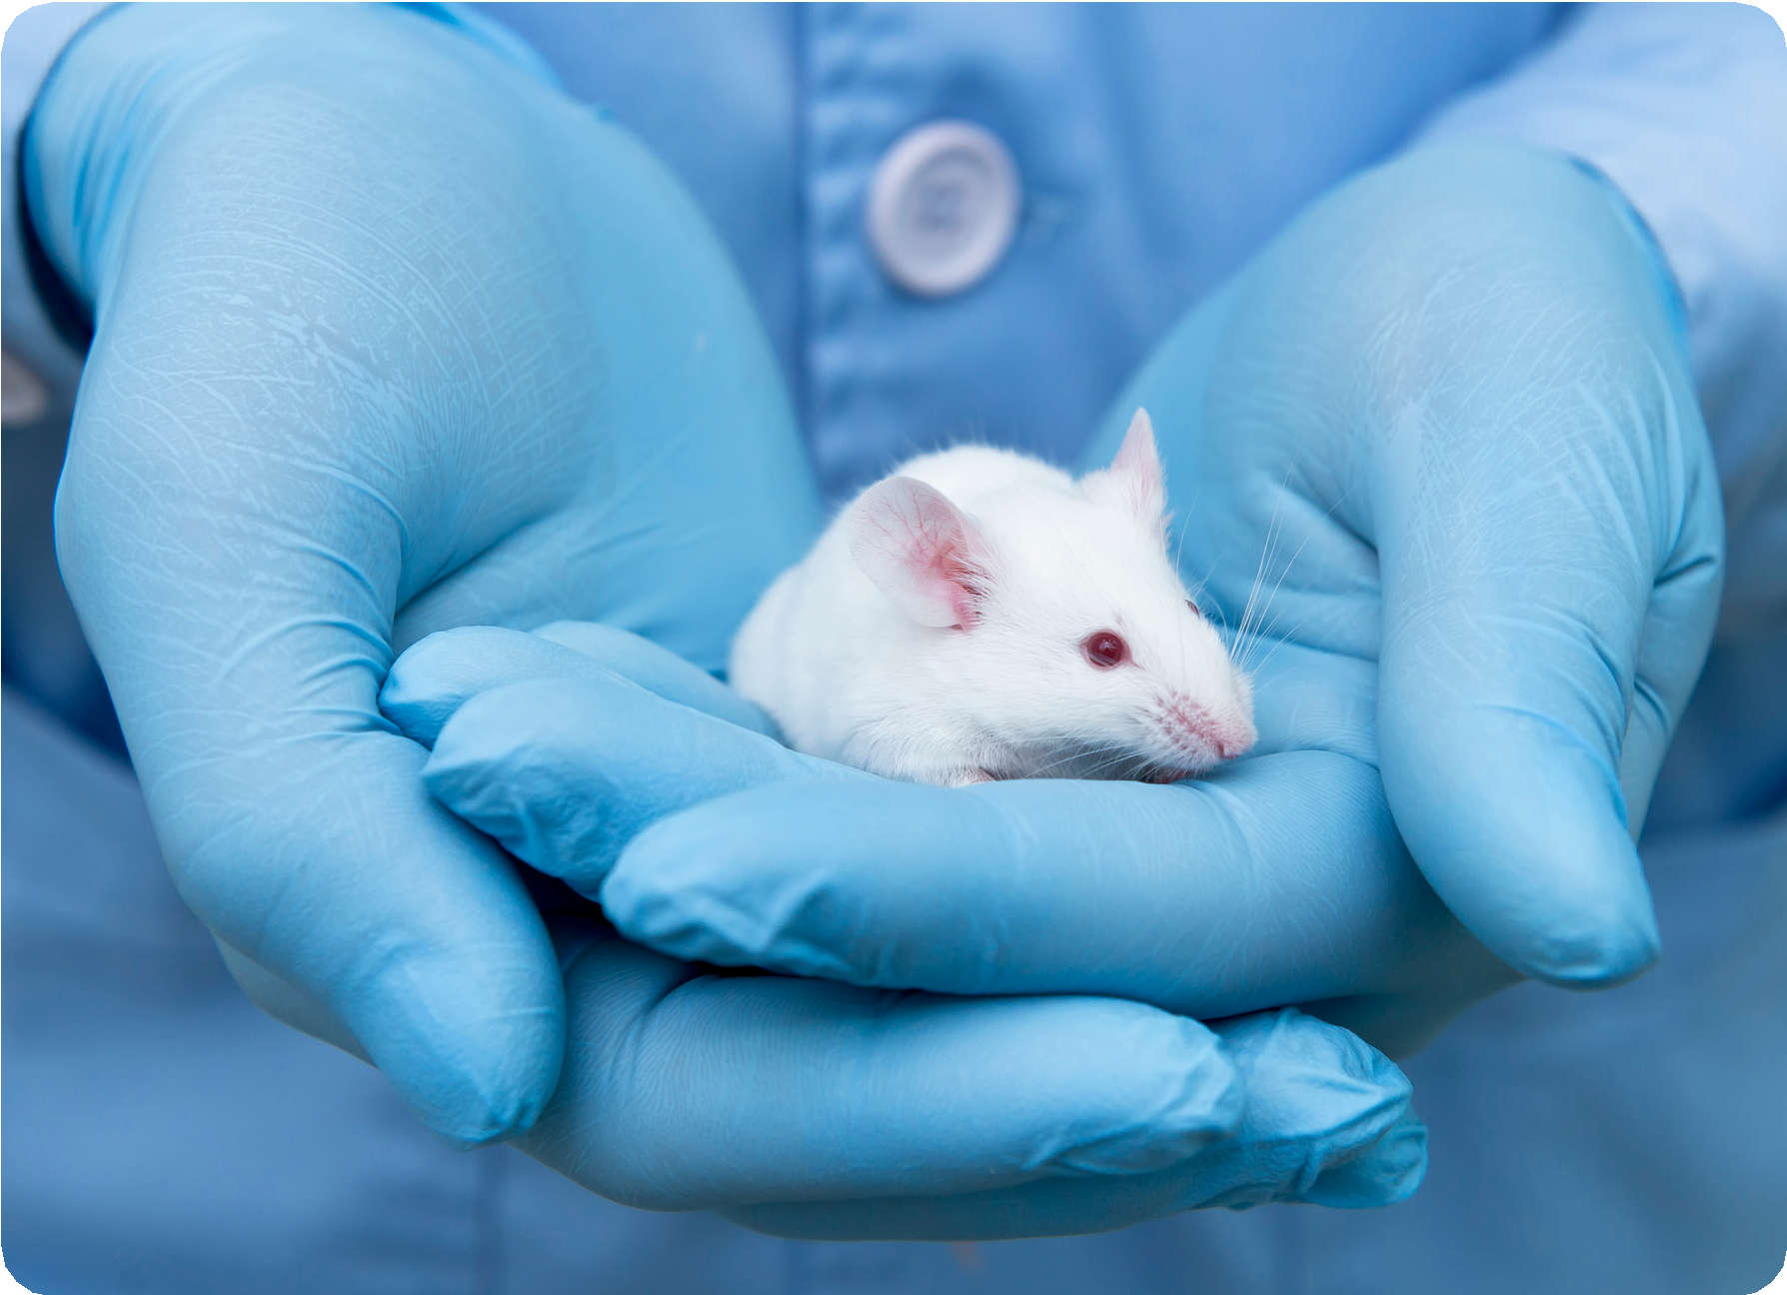
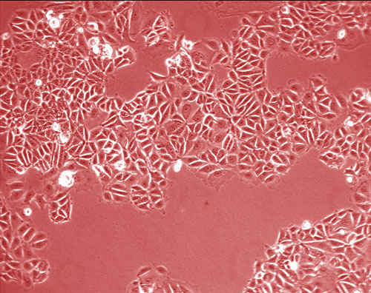
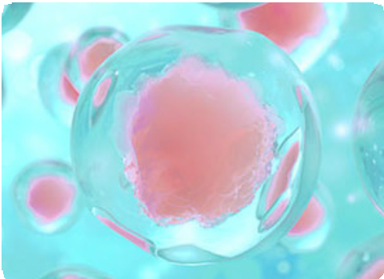
The current preclinical toolbox − the challenges
Scientists have a wide range of preclinical tools available to them for evaluating new therapeutics or molecules
Traditional approaches
2D cell culture
3D organoids
In vivo
Human cells
High Throughput
Physiological relevance
Low content
Whole system
High content
Human translatability
Low throughput
Notes:
In preclinical studies, scientists use a range of tools to help them evaluate the performance of new therapeutics or molecules.
One of the most straightforward traditional approach is the use of 2D and 3D cell models. Advantages include their human origin and high-throughput nature. However, they also demonstrate some limitations. This include limited phyiological relevance because sometimes cell line don’t express the relevant enzymes in human organs. It is also relatively low content because it would be very challenging to set up a multi organ model and examine interorgan cross talk.
Another method is in vivo approach using animal models which allow studies with higher content due to it ability to model whole system interaction. Of course challenges include limited human translability because sometimes animals have a slightly phyiological mechansisms. It is also low throughput because multiple animals will be required for one single study. Gives rise to issues such as high cost and ethical considerations.

Slide 5

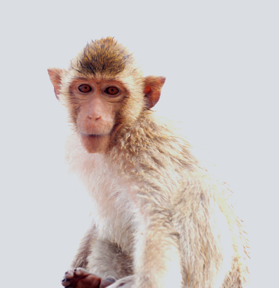
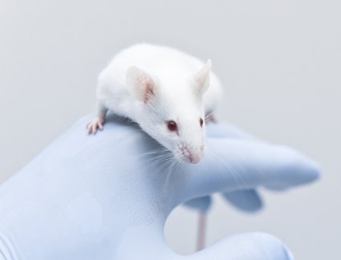
New workflow considerations
Further threats to timelines and costs
Access to NHPs
Access to NHPs is bottlenecking drug development, lengthening timelines and increasing costs
Oligonucleotides
ASO
siRNA
New chemical modalities
Peptides
Biologics
Reduced animal use
The global regulatory landscape is transforming with pressure to reduce animal use (where possible)
bRo5
ADCs
Small
Molecules
Protacs
Notes:
In addition to the challenges I have just mentioned, we are challenged with limited access to NHPs and increasing pressure from regulatory bodies to reduce animal use. This has therefore introduced further threats to timeline and costs regarding the use of animal studies.
It is therefore essential to consider new workflow to tackle increase demand for better preclinical research approach.

Slide 6


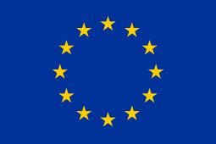


Changes to the regulatory landscape
Our industry faces increasing ethical pressure to reduce the numbers of animals used
US FDA modernisation act Dec 2022
Removed mandate for animal testing at preclinical stage
South Korea, PAAM act – Dec 2020
Promotion of development, dissemination and use of alternatives to animal testing
European Parliament, resolution vote Sep 2021
Supports motion to accelerate transition to innovation without the use of animals
India, New drugs and Clinical trials Rules – 2023
Now allows the use of non-animal and human-relevant methods
Canada, Bill S-5 Act Environmental Protection Act - phase out animal-based chemical toxicity testing - 2022
Moving towards phasing out animal toxicity testing
Notes:
Industry facing increasing ethical pressure to reduce numbers of animals used.
US FDA modernisation act – Dec 2022
Removed the mandate for animal testing at preclinic al stage
Named MPS/organ-on-chip as an example of alternative techniques that can be used to demonstrate drug safety in preclinical studies
Apart from that, introduction of new rules all over the world, all encouraging to reduce the use of animal models

Slide 7
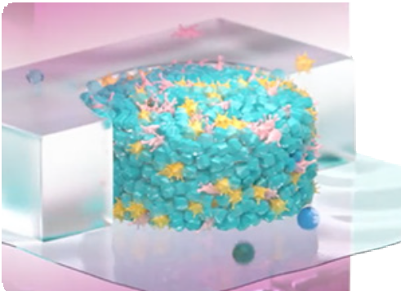
Bridging the gaps: the modern preclinical toolbox
Collective use of traditional and New approach methodologies (NAMs) tools provides more insightful decision making to overcome challenges and mitigate risks
Traditional approaches
NAMs
2D cell culture
3D organoids
In vivo
MPS/Organ-on-a-chip (OOC)
Human cells
High Throughput
Physiological relevance
Low content
Whole system
High content
Human translatability
Low throughput
Human phenotype /translatability
High content
Isolated/
limited system
Medium throughput
Notes:
To address the limitations of current preclinical tools, and also the pressure from different regulatory bodies over the world.
Increase efforts to develop new approach methodologies as a better alternative to animal studies.
In particular, there has been incrasing evidence suggesting that the use of microphysiolologocal system can generate more reliable and human-relevant preclinical data. This could be used in combination with traditional models to and further bridge the gap between preclinical and clinical studies.

Slide 8
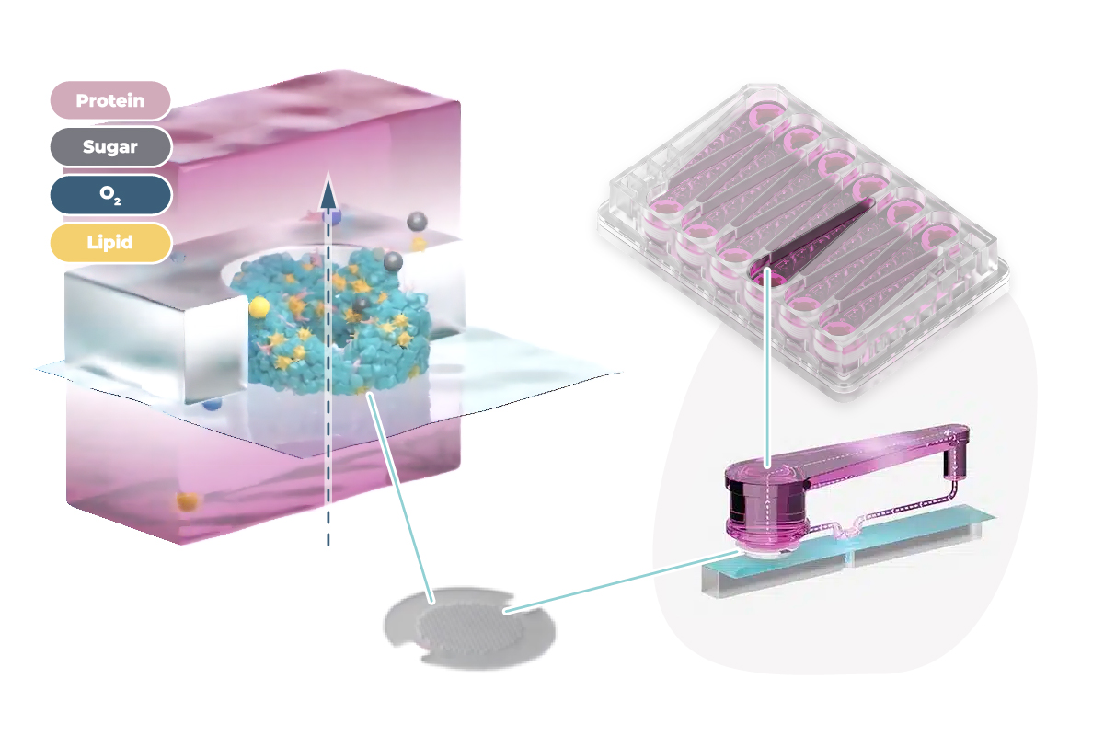
What is MPS?
MPS come in many shapes and sizes but have some common features
Human cells and tissue
Typically grown in three dimensions and with geometrical confinement or patterning
Fluidic flow
Mimic flow of blood, increase O₂ and nutrient supply and provide biomechanical stimuli
Environment control
Mechanical cues and sheer stress, electrical stimulation, control of gas exchange and growth factors
Notes:
MPS are also know as OOC, which are designed to better resemble human biology and they are characterised by some common features.
- One key feature is the use of human cells and tissues, that are normally grown in 3D.
Other features include fluidic flow and environmental control, which increases oxygen and nutrient supply, and also provides different stimulation signal. This can help the system to better mimic what happens in human body.

Slide 9
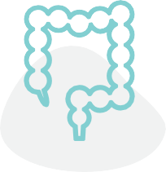
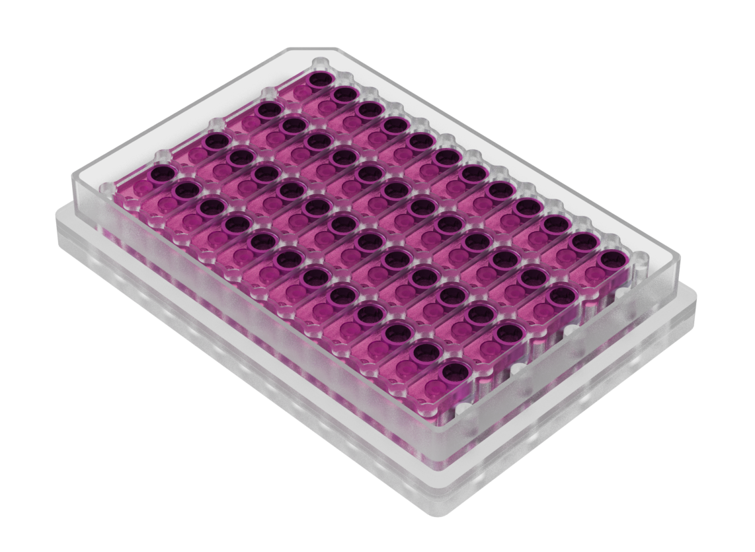
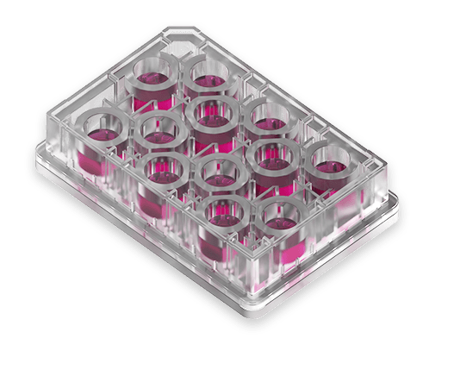
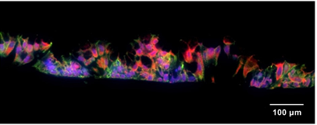
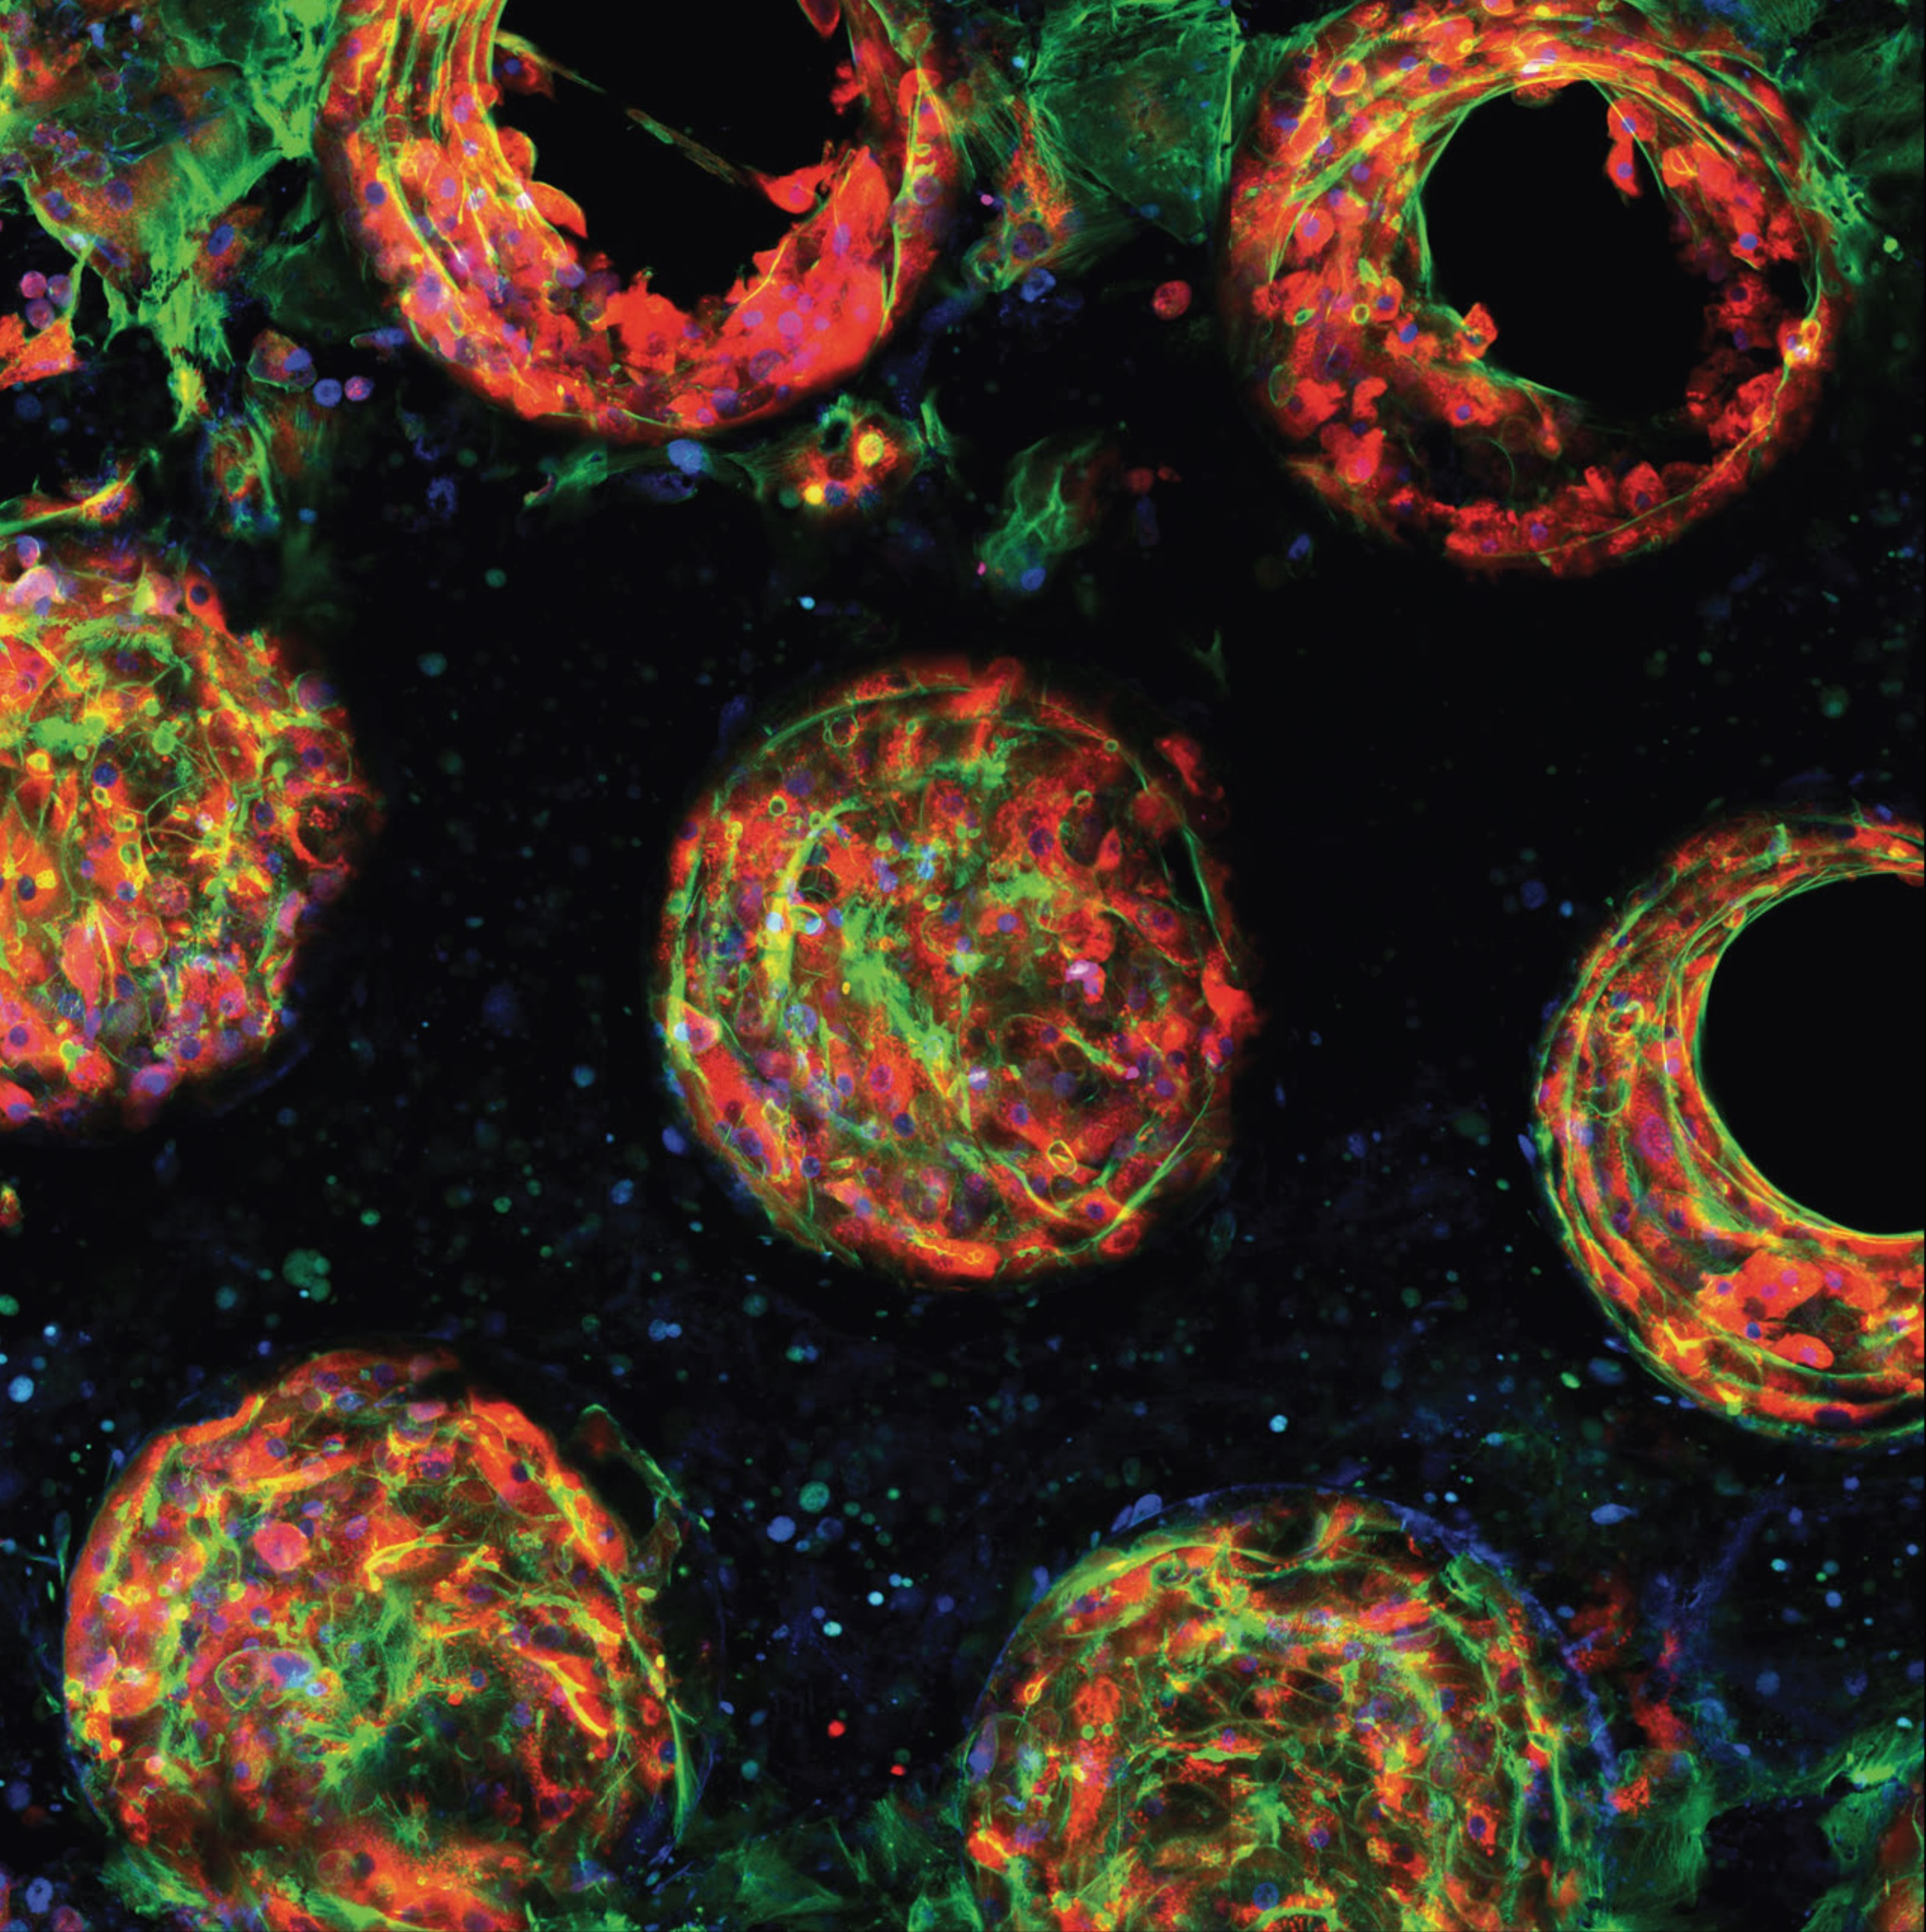
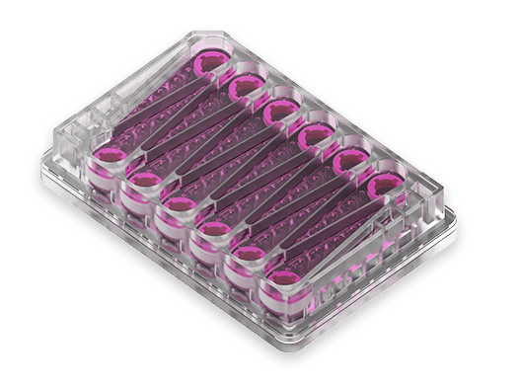
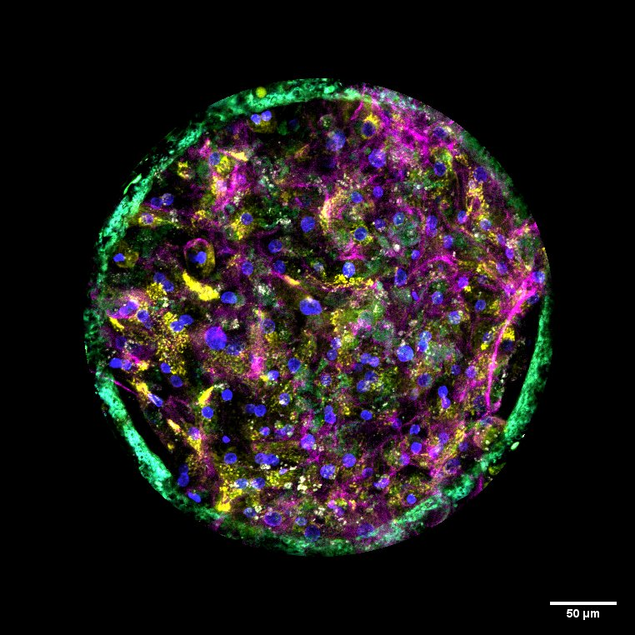
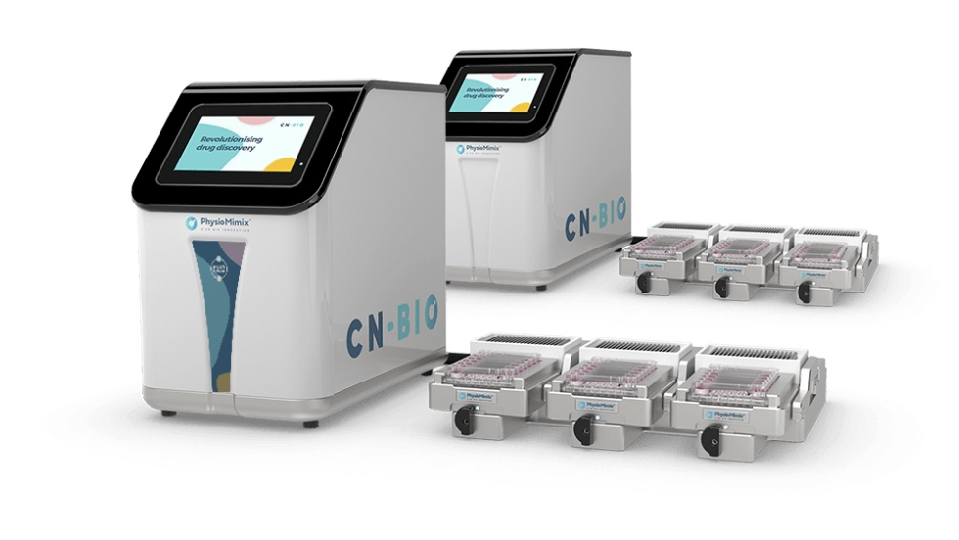
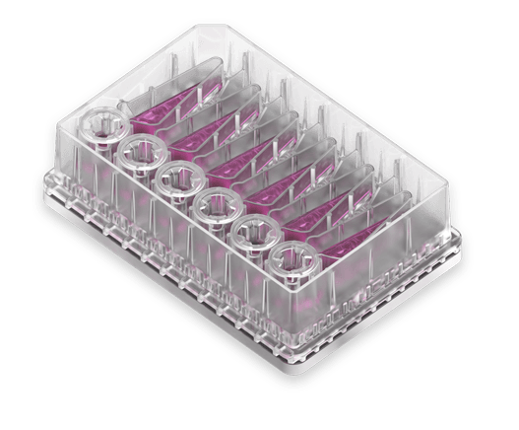
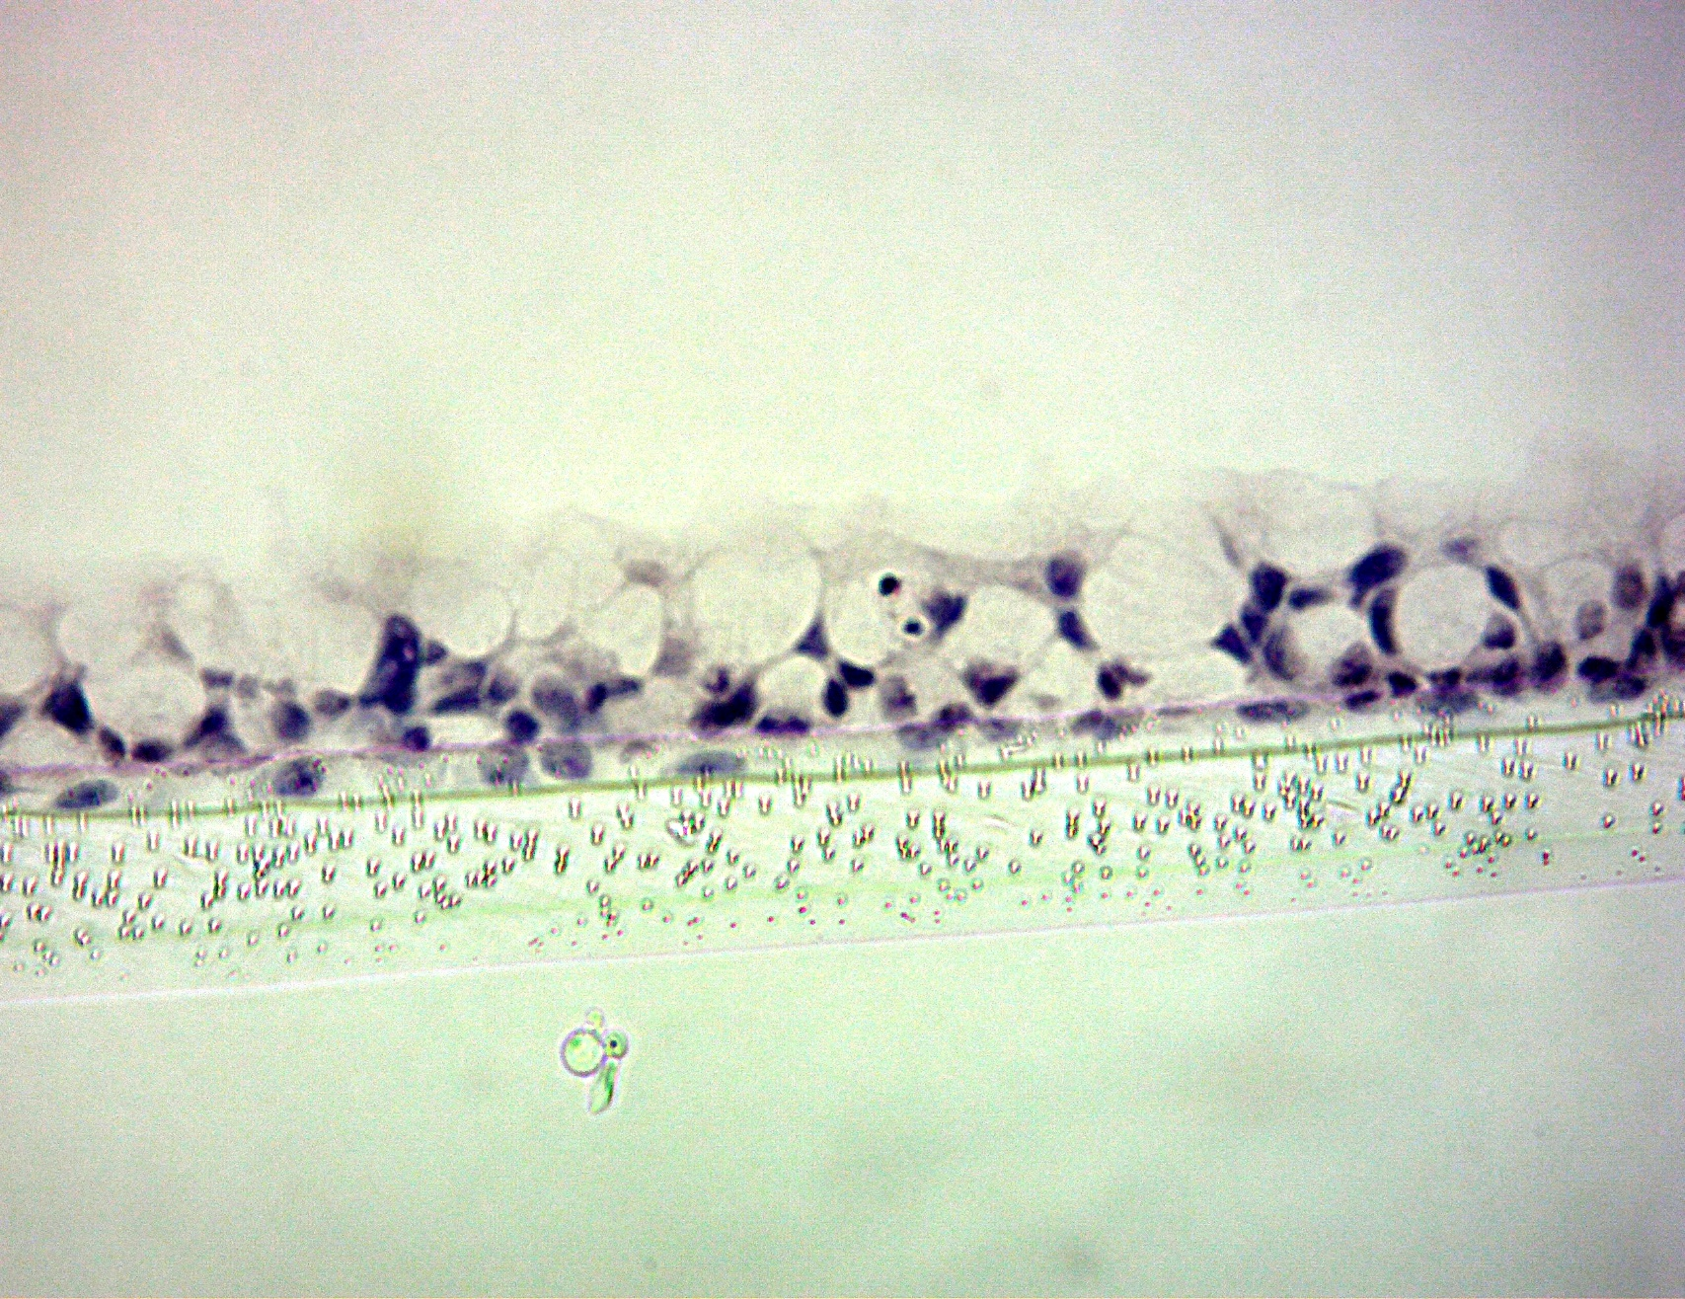
CN Bio’s PhysioMimix® OOC technology
Barrier model
Basolateral flow
Liver model
Individual well/microtissue perfusion
GUT
LUNG
LIVER
Dual-organ model
Interconnected flow
LUNG
LIVER
GUT
Notes:
So here are some examples of our MPS model here at CN Bio called the PhysioMimix OOC. MPS The picture on the bottom right shows the typical set up of Physiomimix, with everything connected to and controlled by this controller.
One example is the liver model which features formation of a 3D microtissue. This can be used for many applications related to the liver such as drug toxicity studies and disease modelling.
Next up we have barrier model for applications such as lung or gut model. could be used to study the transport of substances across a membrane.
Dual-organ model which links a barrier model with a liver model. Interconnected flow between the 2 organ models allows the user to simulate interorgan crosstalk for a wide range of applications which I’ll go through some examples later.

Slide 10
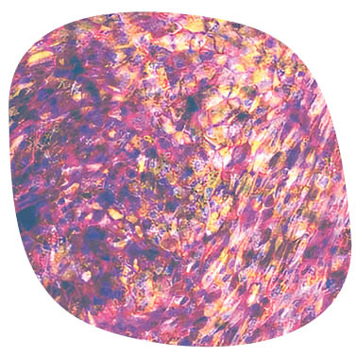
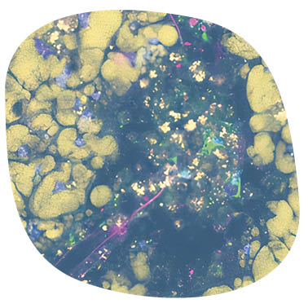
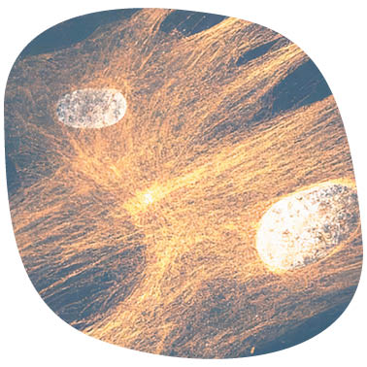
Key OOC applications include:
ADME
Disease modeling
Safety toxicology
Drug absorption
Drug metabolism
Drug bioavailability
NASH
Hepatitis B
Respiratory infection
DILI
Immune DILI
Disease + DILI
Notes:
While all MPS models have their own applications, these 3 are the key applications of our PhysioMimix technology, so today we will focus on demonstrating how this technology are predictive of human biology and how this could help bridge the gaps in your current workflows and improve their effectiveness.

Slide 11
Liver-on-a-chip
Notes:
In the following slides Expand further on how we model the human liver using our MPS technology, and how it is able to resemble the structure and functionality of an actual human liver

Slide 12
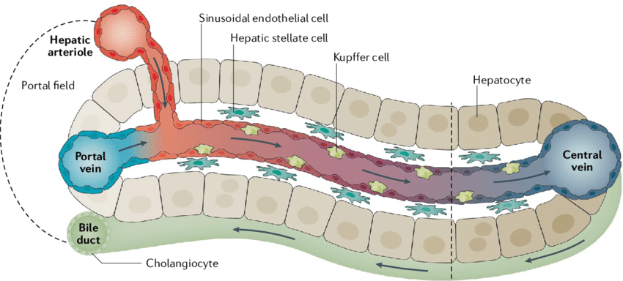
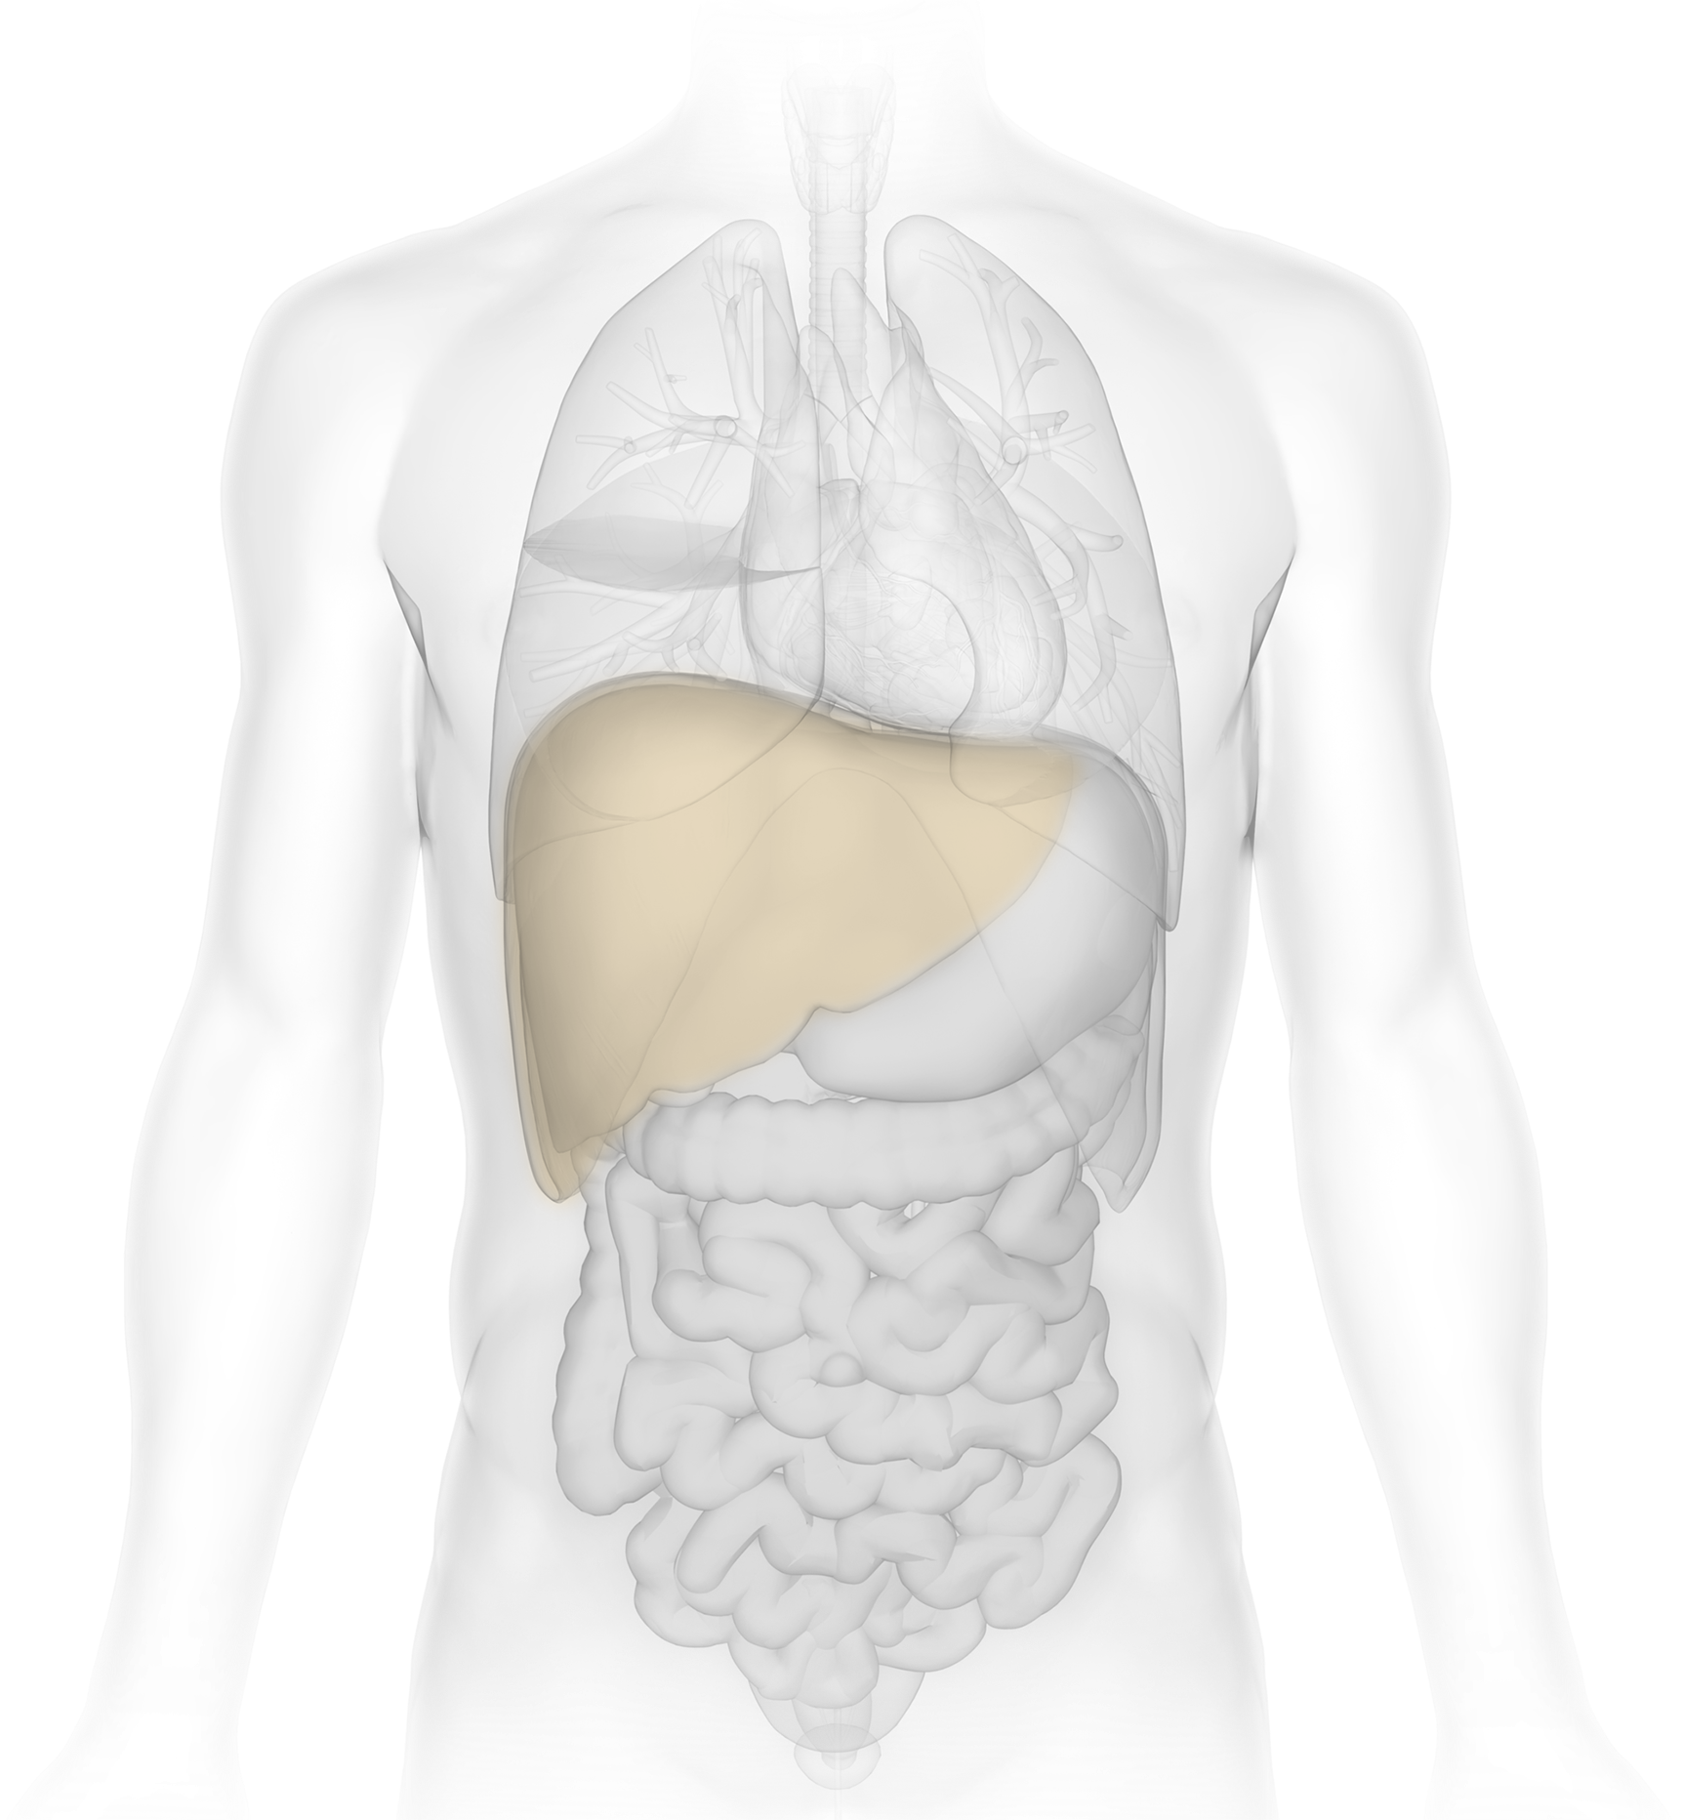
Crucial hepatic features to recapitulate in vitro​
Albumin production
>37 µg per day per 1 million hepatocytes
Urea synthesis
>56 µg per day per 1 million hepatocytes
Markers of hepatic damage
ALT/AST release, LDH release, miR122, cytokine production
Phase l and Phase Il enzyme expression
CYP3A4, CYP2B6, CYP2C9, CYP2C19, CYP1A2, CYP2D6, CYP2E, UGTIAT, GSTAT
Transporter expression
SLCOIBT, SLC22A1, ABCC2, ABCG2
Notes:
To build a human liver model, there are a couple of crucial hepatic features that must be recapitulated in vitro. Functional human liver is characterised by a number of features including albumin production, urea synthesis,various markers of hepatic damage
Other important factors include the expression of various metabolic enzymes and transporters. Liver is a key site for metabolism for many drug compounds and therefore it is very important that an in vitro model is able to reproduce these features.

Slide 13
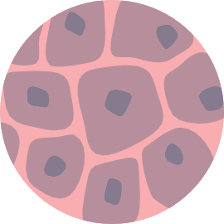
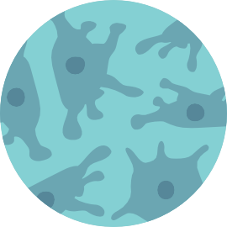
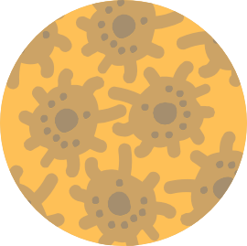
Building models of the human liver-on-a-chip (Liver MPS)
Media perfusion through microtissue produces functional hepatocytes
PhysioMimix® Multi-chip Liver-12 plate
Primary
Human Hepatocytes
Human Kupffer cells
Human Hepatic Stellate cells
3D scaffold
Notes:
To build human models of the liver, validated cells seeded on collagen-coated scaffolds. Examples of primary cells include human hepatocytes, which is the main resident cell type in human liver. Culture on its own or co-culture with other resident cells in the liver such as Kupffer and stellate cells. Kupffer cells are resident liver macrophages whereas stellate cells are involved in response to liver injury, so the user has the option to seed a combination of these 3 cell types depending on their speicifcx experiment

Slide 14
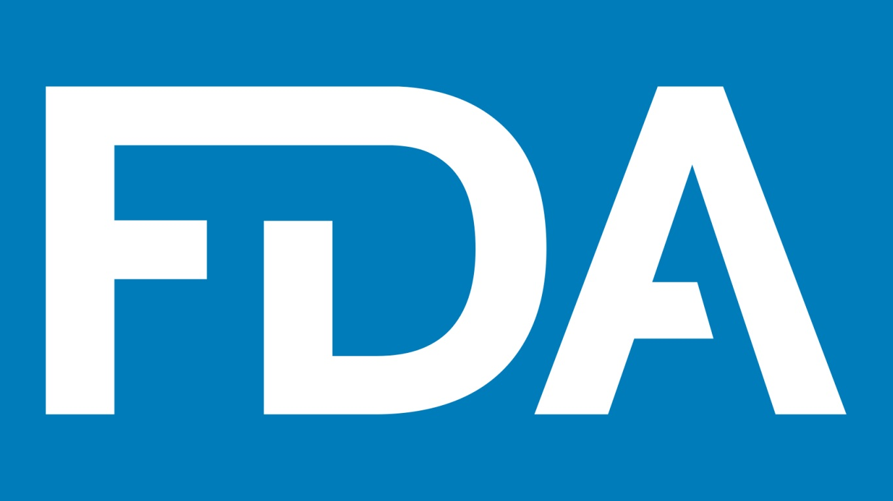
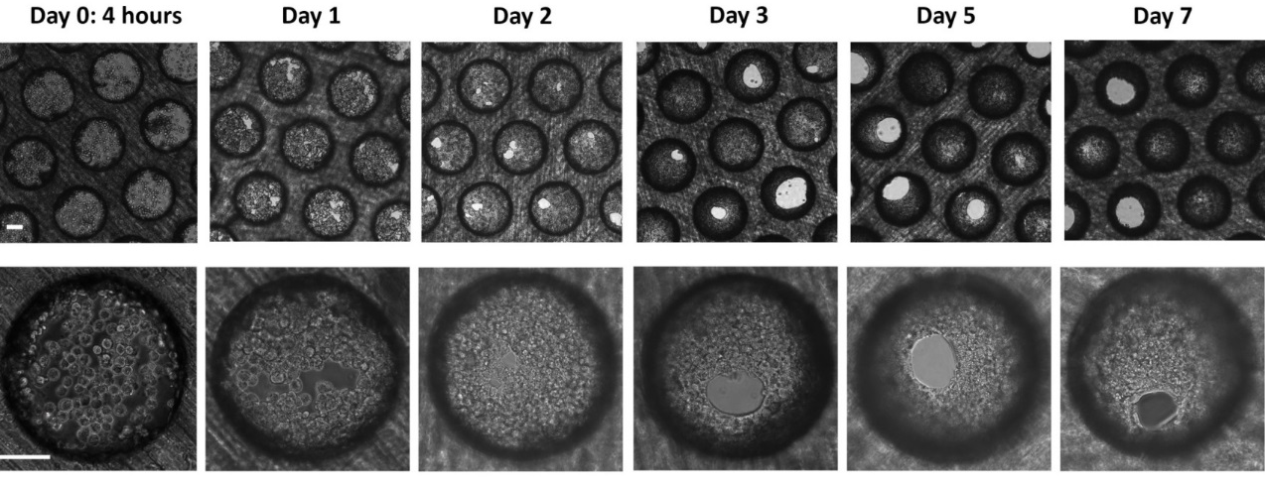
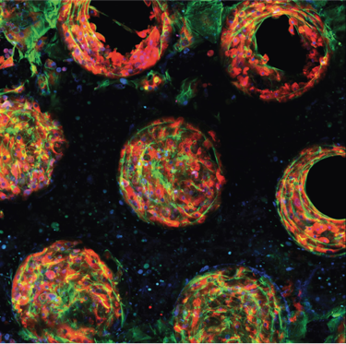
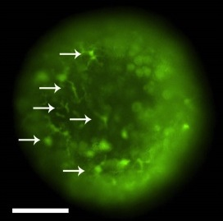
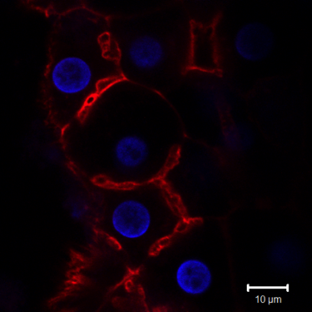
Liver-on-a-chip (Liver MPS) mimics human biology
Metabolic activity
Liver MPS
Spheroids
Sandwich culture
Morphogenesis from single cells to micro-tissues
Day
Albumin production
Albumin Cytoskeleton
Bile canaliculi
Tight junctions
Day
Notes:
The MPS liver model has been successfully characterised both funcationally and structurally. This panel of microscopy images demonstrates the development of MPS liver model over time, and that 3D microtissue structure was formed within 7 days.
After a 3D microtissue has been formed, the model displayed positive expression of bile canaliculi which is a key hepatic structure, and also expression of other structural biomarkers including cytoskeleton and tight junctions.
Here are some data previously publichsed by the FDA analysing the MPS model for functionality, they demonstrate higher metabolic activity and albumin production than traditional spheroids and sandwich culture
This indicates that liver model generated using MPS demonstrate an improved functionality for downstream applications.

Slide 15
Barrier models
Notes:
Barrier model is another application of ours which are particularly suitable to study the transport of molecules across a membrane.

Slide 16
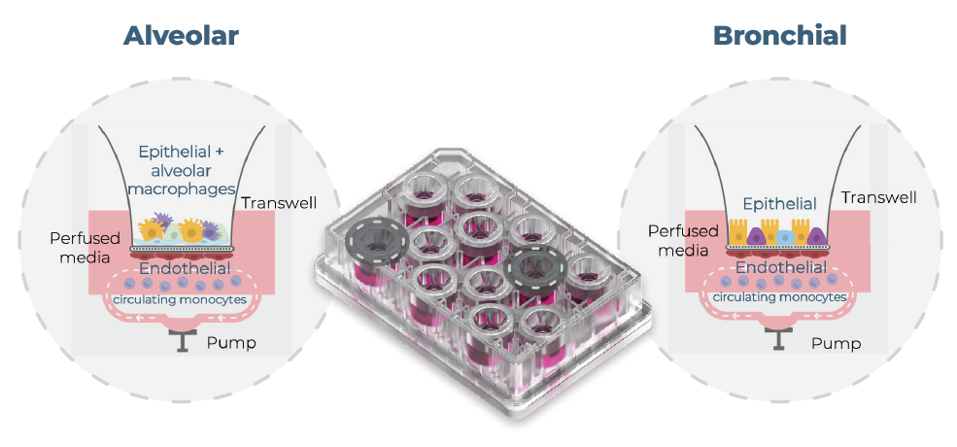
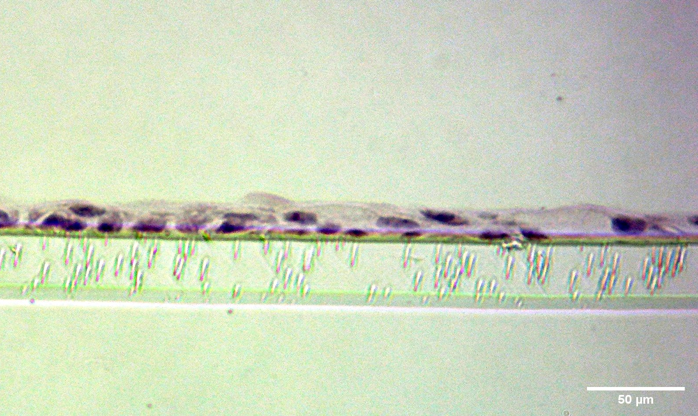
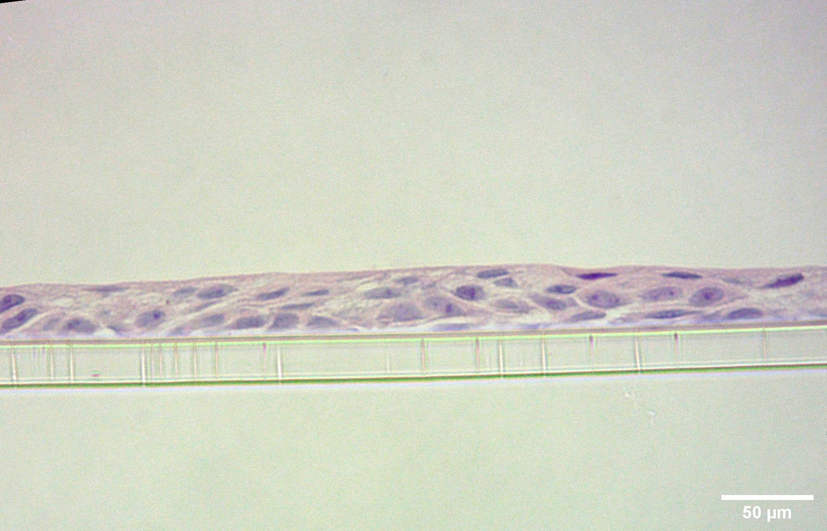
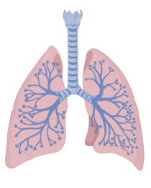
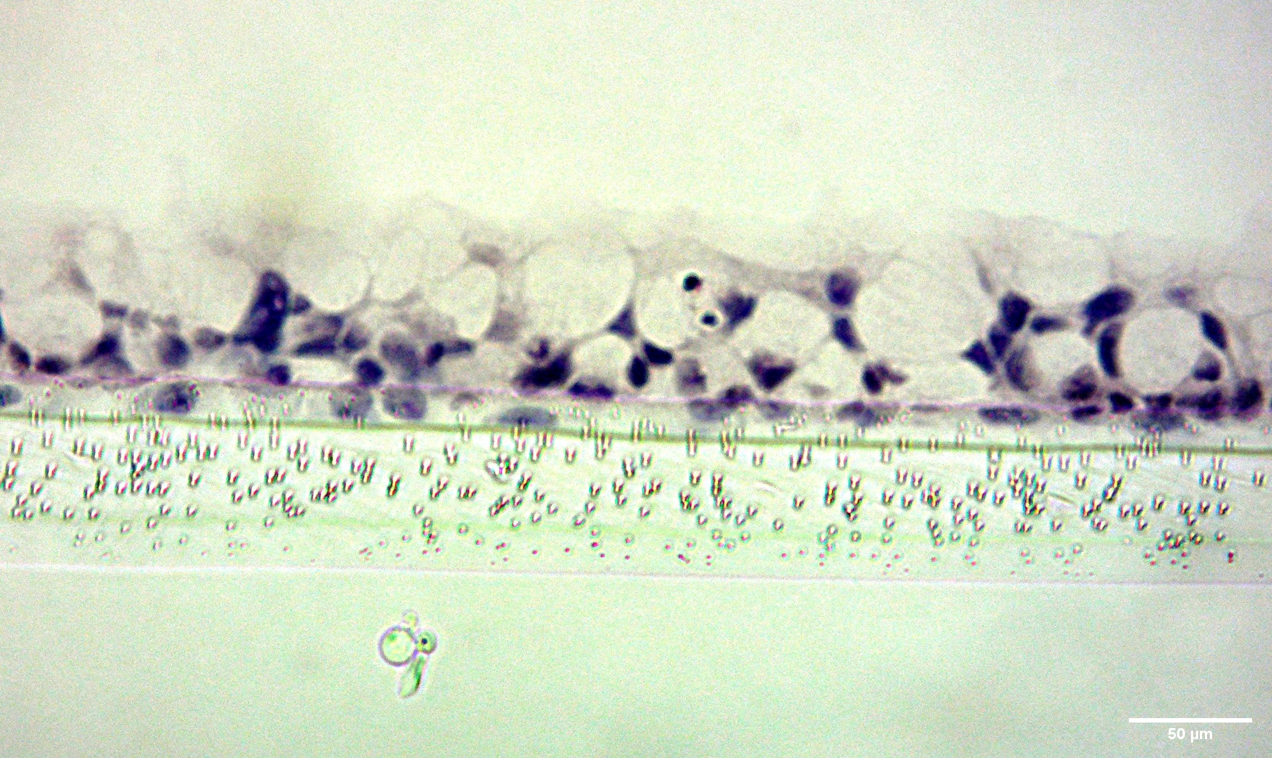
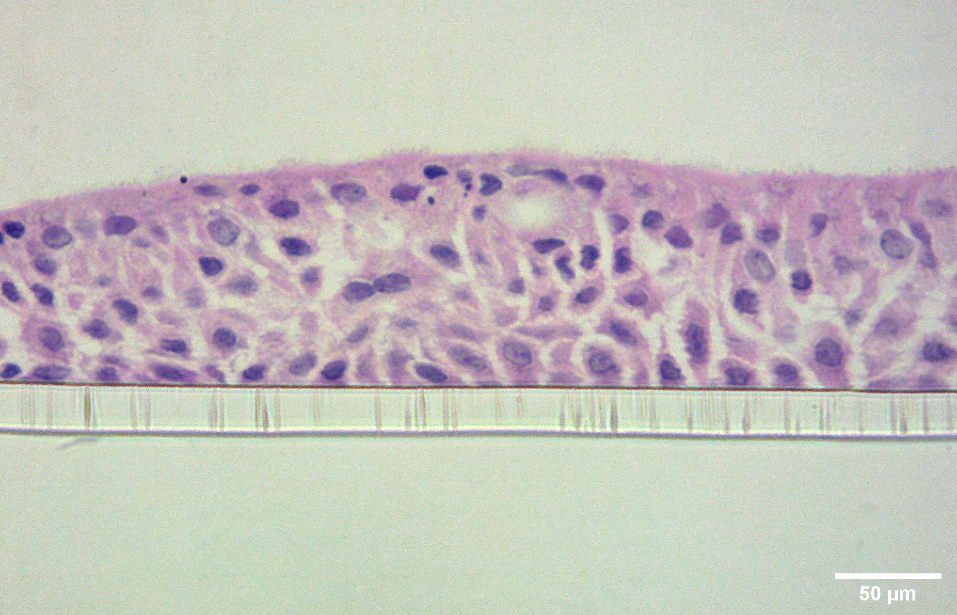
Building models of the human lung-on-a-chip (Lung MPS)
Primary lung cells are seeded onto Transwell® inserts, accompanied by perfusion, to model the human upper and lower airways
Superior tissue structure formation
Alveolar model
Bronchial model
PhysioMimix® Multi-chip Barrier plate
Static
Perfused
Increased differentiation into distinct pulmonary cell populations
Potential research applications
Alveolar
Bronchial
Respiratory infections
Disease modelling
Inhalation medicines
AQP5 – AT1 Cells
SFTPB – ATII Cells
MUC5AC – Goblet Cells
SCGB1A1 – Club Cells
Static
Perfused
Notes:
One example of our barrier model is our lung MPS. In this case, primary lung cells are seeded onto transwell inserts to establish a model for the upper airways which is the bronchial model or the lower airway which is the alveolar model. Again these cells could be co-culture with endothelial cells or circulating immune cells depending specific applications. Our physiomimix barrier plate can fit up to 12 transwells and is featured with barrier flow to allow perfusion throughout the cell culture.
Upon comparison with traditional static culture, our MPS lung model demonstrate a higher physiological relevance to human both genotypically and phenotypically. Increased mRNA expression for pulmonary biomarkers of specific cell population. Histology images also suggested a superor tissue formation. For example in the albeolar model, 3D structure consisting of air sacs which is comparable to alveolr structure in vivo.
With this human relevancy, Makes it suitable for different applications such as respiratory infection, disease modeeling Such as COPD and cycstic fibrosis. And also properties of Inhalation medicine.

Slide 17
Multi-organ MPS: Gut-Liver axis
Notes:
Moving on from single organ models. Multi-organ MPS is one of our newer concepts. As I’ve previously mentioned, it can link 2 separatae organ model together means of fluidic flow. So in the following slides, I will be using Gut-Liver axis as an example to explain the values of multi-organ MPS in improving the drug discovery workflow.

Slide 18
Multi-organ MPS
Fluidically linked organotypic models allow modelling of complex disease processes, biodistribution of molecules and organ-organ crosstalk
Modeling interorgan crosstalk
Liver
Improved prediction on biological processes
Mathematical modeling for improved translation to human
PBPK model
Multi-organ MPS
Notes:
What’s so attractive about a multi-organ MPS features fluidically linking 2 separate models into a single plate which could in turn allow….
With the fluidic flow there intrioduces a potential for improved prediction on biological processes, such as predicting phamakokinetic properties of drug compounds and can also be used in conjction w Mathematical modelling

Slide 19
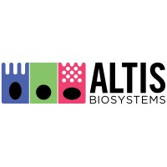
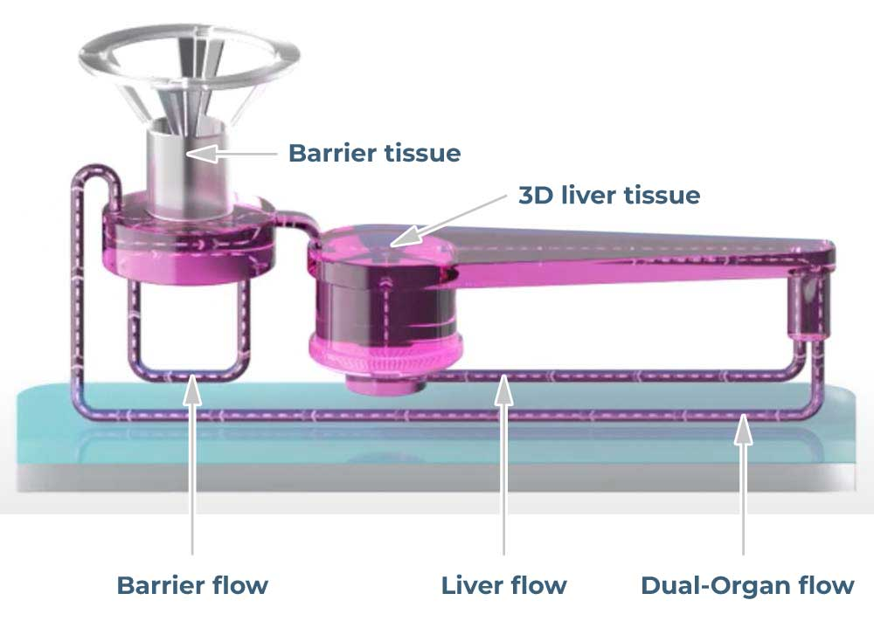
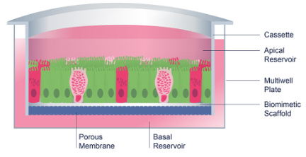
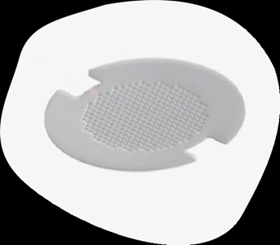
Multi-organ MPS: Gut/Liver MPS
In partnership with…
Combining a Primary Gut model (RepliGut®) with our bespoke Liver MPS
Gut
Liver
PhysioMimix® Multi-organ system + Multi-chip Dual-organ plate
Notes:
The concept of multi-organ model is to link 2 models of primary human nature together, and one of our most recent project is the Gut/Liver MPS. In this project, we collaborated with Altis Biosystems and incorporated their Repligut platform into our Liver MPS.
RepliGut is primary gut model that was derived from crypt-epithelial stem cells from human jejunum samples. It could be cultured on the transwell insert and can again fit into the transwell compartment and establisjh a fluidic link with our liver model. By linking 2 primary models together, this Gut-Liver MPS, It has valuable such as estimating drug properties which I’ll through later.

Slide 20
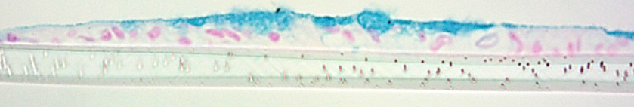
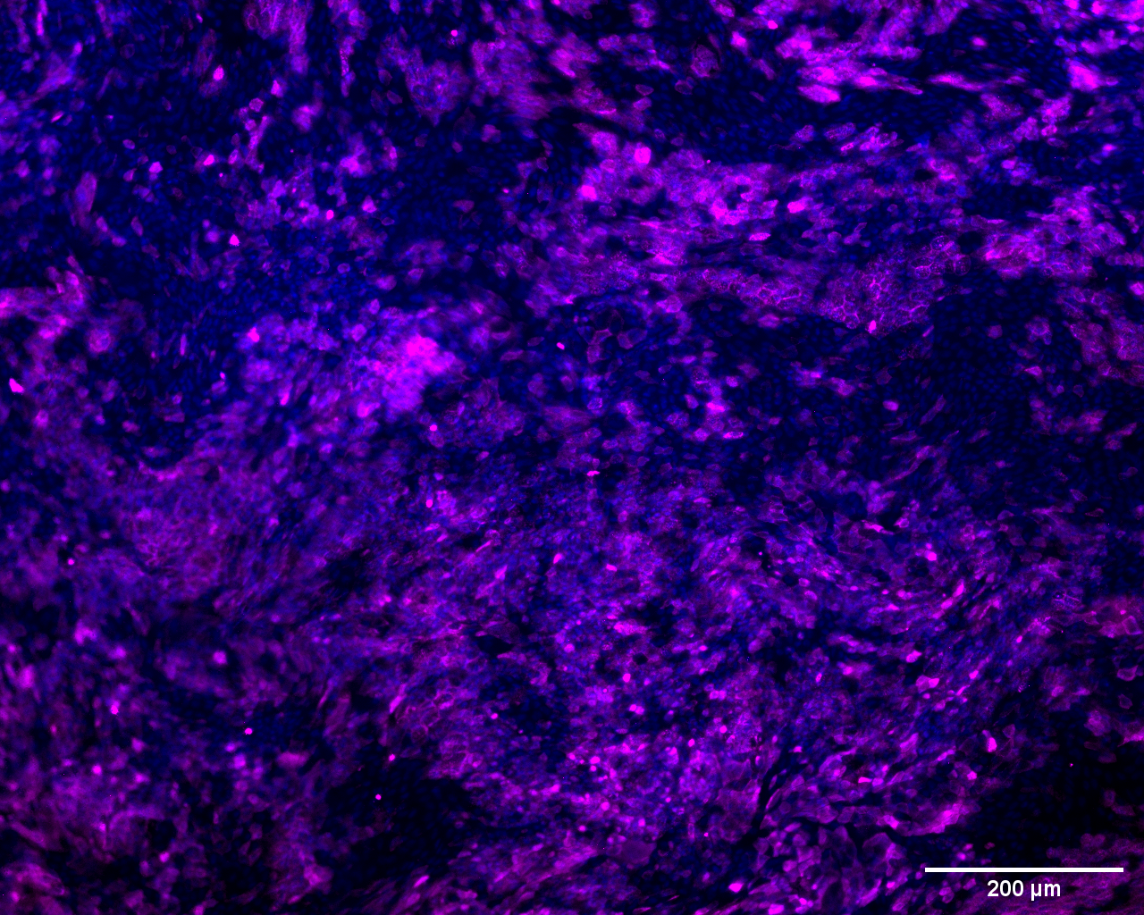
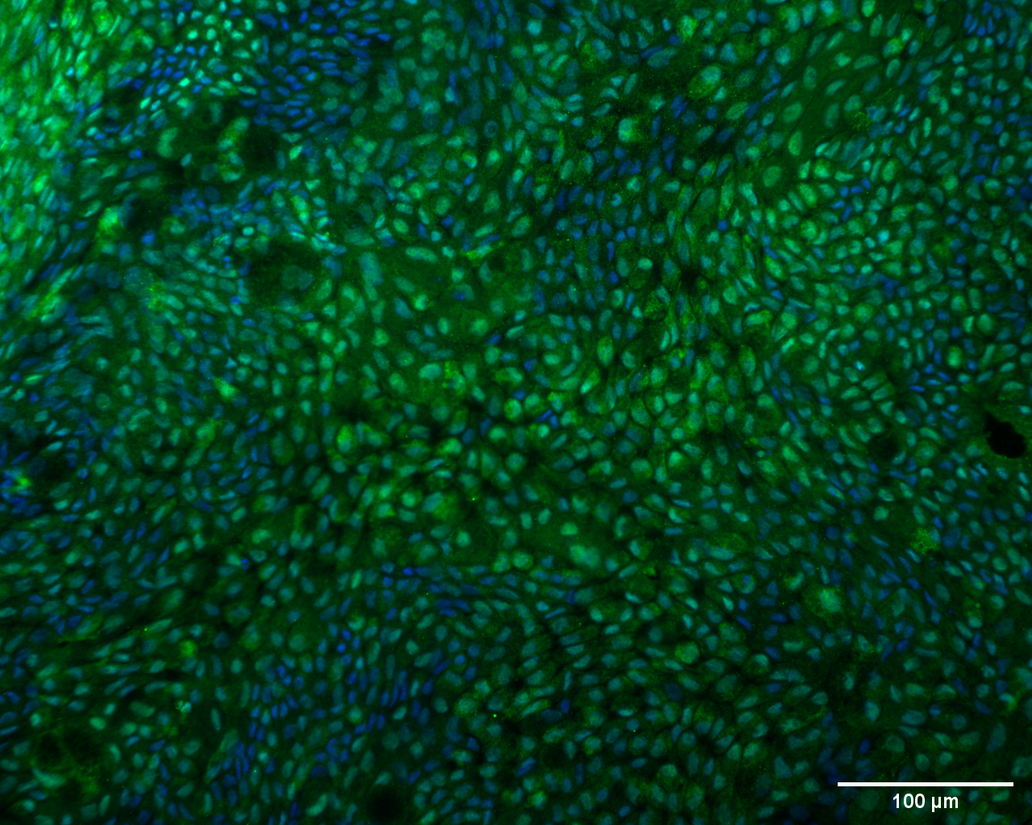
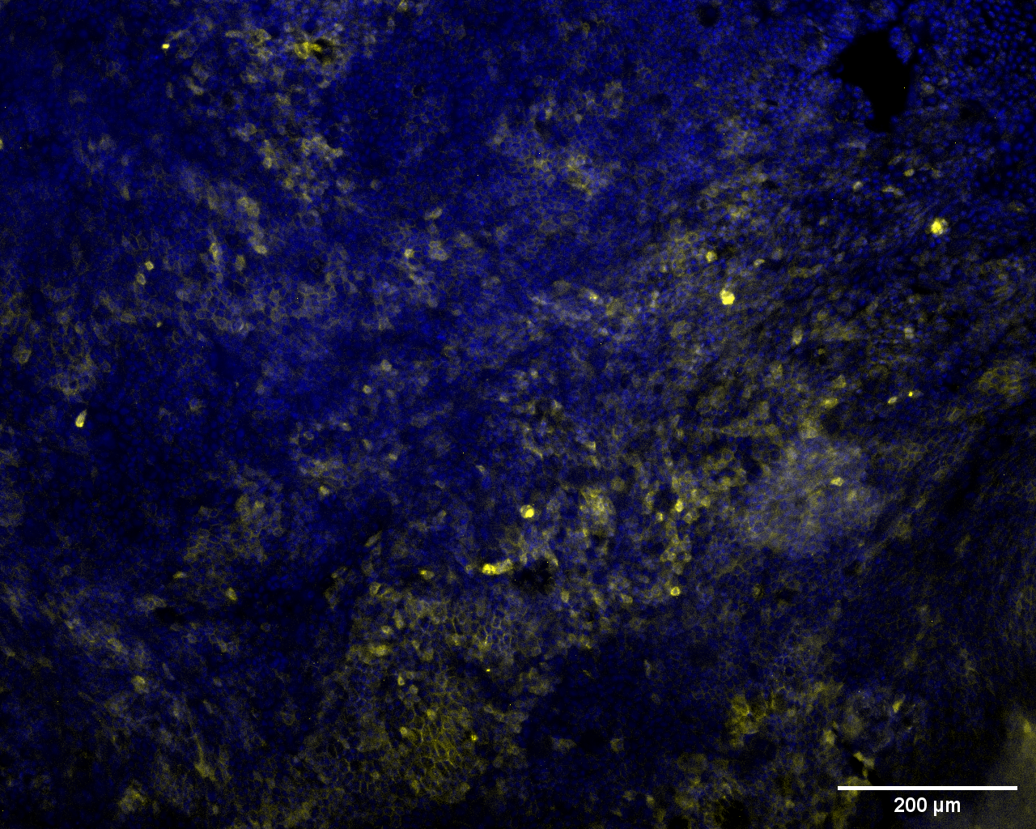

Primary gut barrier: RepliGut®
In partnership with…
A more human-relevant model than CaCo-2
Distinct proliferative and differentiative cell populations
Improved expressions of key ADME biomarkers for intestinal functionality
Intestinal marker expression
Distinct and continuous layer of mucus
RepliGut®
Caco-2 only
Villin
DAPI
CDX2
DAPI
MUC2
DAPI
Notes:
The RepliGut culture goes through 2 major phase, expansion and differentiation, each characterized by a specific pattern of gene expression. In terms of physiological relevance, A fully differentiated barrier is have been shown to express key intestinal markers.
Another advantage of using REpliGut is that it demonstrates higher human-relevancy than Caco-2 cell line. Which is the current standard for in vitro gut model but as I’ve mentioned, some cell lines demonstrate limited human relevancy due to their lack of expression on metabolic enzymes. Compared to Caco-2, the repligut model is characterized by improved expression of key ADME biomarkers . When looking at the physical properties of the culture, Repligat displayed distinct and continuously layer of mucus, which was otherwise absent in the Caco-2 model. Because of the higher human relevancy, Specifically relevant for downstream studies.

Slide 21

Multi-organ MPS: Gut-Liver axis
Hepatic functionality preserved
Integrating RepliGut® into a Gut-Liver MPS
Albumin
CYP3A4 Metabolism
Barrier of intestinal cells remained intact
Transepithelial electrical
resistance (TEER)
Permeability to
Lucifer Yellow at 48h
Successfully metabolized 7-HC
Notes:
After demonstrationg human-relevancy of the repligut model, The next step was to try integrating RepliGut into our MPS model and establish a co-culture with the liver model. We managed to establish a special co-culture media that retains functionality of both organ models for at least 48 hours.
We performed some measurements and demonstrated that the primary gut barrier remained intact following exposure to fluidic flow and also exposure to the liver culture.
In terms of liver culture, the functionality of the liver model in co-culture is comparable to the single organ control. And this could be reflected in terms of albumin production and CYP3A4 metabolic activity.
To validate the collective metabolic capacity of the gut and liver models, we dosed the model with a compound called 7-HC and measured its concentration in circulating media overtime. 7-HC is a compound that can be meatbolsied by both the gut and liver which has been successfully deomstrated by our multi-organ model. This proof-of-concept model has therefore been validated to study the properties and metabolic profiles of more drug compounds.

Slide 22
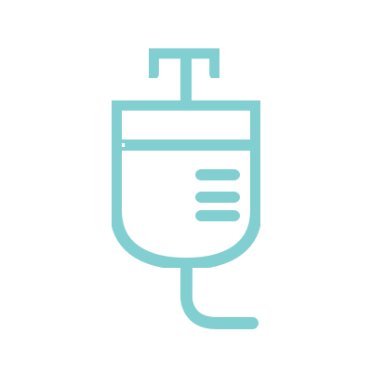
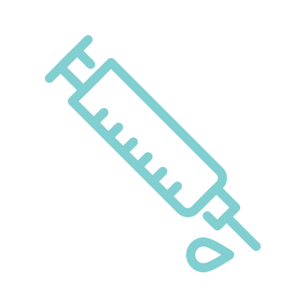





Gut/Liver MPS for Bioavailability profiling
In partnership with…
Bioavailability: Fraction of drug administered reaching the systemic circulation
Oral dosing
Intravenous dosing
IV dose
Dosing location: Transwell® apical compartment
Models the combined effects of intestinal absorption and hepatic metabolism
Gut-Liver crosstalk facilitated by interconnected fluidic flow
Oral dose
Dosing location: liver compartment
Models the changes in drug concentrations in systemic circulation over time
Gut barrier not included in IV dosing model
Barrier flow
Liver flow
Interconnect flow
Data analysis
Sampling at defined timepoints
LC-MS analysis to determine changes in concentration of parent compound (and metabolites if desired)
Notes:
This multi-organ model has valuable applications in bioavailability profiling of drug compounds. Bioavailability is a concept which measures the fraction of a drug adminisred reaching the systemic circulation. For example, if you swallow a pill, bioavailability measures how much of that drug was absorbed through your gut in the digestive system into the bloodstream.
Given the open-well design, this Gut-Liver model has the flexibility to simulate both oral and intravenous dosing of drug compounds, and For oral dosing, the drug is added at the apical side of the Transwell compartment, directly onto the primary gut barrier. Depends on the transport mechanisms of the specific drug, the dug may be able to be transported across the gut barrier into the circulating media and come into contact w the liver culture. The multiple fluidic flow in this Gut-Liver MPS allows the modelling of the combined effects of intestinal absorption and hepatic metabolism for drug compounds.
In terms of intravenous dosing, the drug could be added directly into the liver compartment. This set up Models the scenarios where the drug was injected directly into the bloodstream and travlled to the liver for metabolism.
To estimate the pharmakokinetic profile of the drug, media samples can be taken at multiple timepoints and analysed by LC-MS to determine the changes in drug concentration overtime.

Slide 23

Case study: Midazolam
In partnership with…
Short-acting hypnotic sedative drug with rapid onset
Commonly used in seizures, anaesthesia and anxiety disorders
Primarily metabolized by CYP3A4 – with growing evidence suggesting the importance of the intestine as a site for first-pass metabolism
Metabolic pathway
RepliGut® CYP3A4 expression
Notes:
Here is a case study where we dosed our gut-liver model with the drug Midazolam. Primarily metabolized by CYP3A4. Increasing evidence suggest that the intestinal is an important site for first metabolism of this drug, in addiotn to the liver
This is another piece of evidence supporting why RepliGut primary cells might be a more suitable model for drug profiling than the Caco-2 cell line, due to the higher expression of the CYP3A4 enzyme.

Slide 24
Case study: Midazolam
In partnership with…
Improved estimation of oral bioavailability in Gut/Liver MPS with RepliGut®
Oral bioavailability estimated with Gut-Liver MPS vs. human and animal models¹
Drug clearance and metabolism
Concentration of Midazolam in
system media
Total fraction of Midazolam remaining in all compartments at 48h
1-hydroxymidazolam in gut apical compartment at 48h (peak area)
Gut-Liver (50µM dose); Liver only (5µM dose)
Fractionally higher drug clearance in Gut-Liver MPS model than conventional CaCo-2
Increased metabolism into 1-hydroximidazolam by RepliGut® correlated with CYP3A4 expression
Notes:
Throughout this proof-of-concept experiment, we completed several sets of measurements and analysis. We have established 2 sets of Gut-Liver models, one with the primary REpliGut and the other with the Caco-2 cell line, and we compared these 2 sets of results side by side. When looking at the changes in the parent drug concentration in circularing media, there was a higher peak in the model with Caco than the model with RepliGut. If we combine this observation with the total fraction of parent drug remaining, we could see that the model with RepliGut demonstrated a higher clearance of the drug.
We have also estimated the amount of metabolites present, which is 1-hydroxymidazolam, by obtaining the peak area. Results suggested there were more metabolites present in the model with RepliGut than caco-2 cell line, which correlates with the CYP3A4 expression in the 2 model.
Carried out further calculations to estimate oral bioavailability of a drug and compare them with literature. Compared to caco-2 model, The bioavailabiliy estimated by the model with REpliGut is much closer to clinical data in humans. When comparing with animal studies in literature, our model also demonstrated an equivalent performance to dog and rat models, if not better. This proof-of-concept study has provided promising results, suggesting that a primary cells in MPS model can play huge potential in giving more accurate estimation on human data.

Slide 25
Summary
Recapitulation of physiological conditions in different organ models
Great potential for more predictive preclinical drug discovery studies
Enable drug developers to gain earlier insight into drug properties and improve translatability to clinical studies
Notes:
Here are a few take home points summarising the potential of MPS technology in preclinical drug discovery.
- MPS models, with incorporation of primary cells, has been able to model different physiological conditions in multiple human organs
- For this reason, MPS demostarte Great potential for future drug discovery studies to be more predictive
- and finally, a hopeful next step would be to enable drug developer to gain earlier insight into drug properties and better translate these findings into clinical studies
Overall, hopefully with further development, MPS will be able offer an in vitro solution to reduce the use of animal testing and improve the drug discovery landscape.

Slide 26

Acknowledgments
Dr. Yassen Abbas
Dr. Audrey Dubourg
Dr. Emily Richardson
Dr. Dharaminder Singh
Altis Biosystems
Thank you!
For further info please contact
Hailey.Sze@cn-bio.com
Notes:
Before coming to an end, I would like to give special thanks to my colleagues here at CN Bio and also at Altis Biosystems.
Thank you everyone for your attention. There seems to be some time left for Q&A. Any questions, please enter in the chat.

